Slide 1

Nutritional deficiency in patients with Chronic lower limb ulcers
Emmanuel U Ndayisaba, Lyell McEwin Hospital, Adelaide, South Australia
Ramandeep Kaur, Wagga Wagga Base Hospital, Wagga Wagga, NSW
David Airey, Riverina Endovascular, Wagga Wagga, NSW

Slide 2


DISCLOSURES
The Authors have no interests to disclose

Slide 3
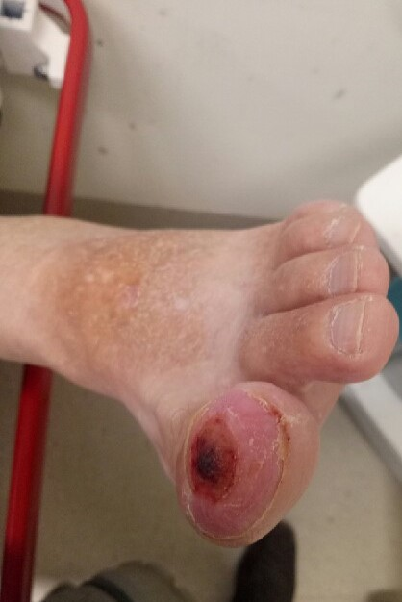
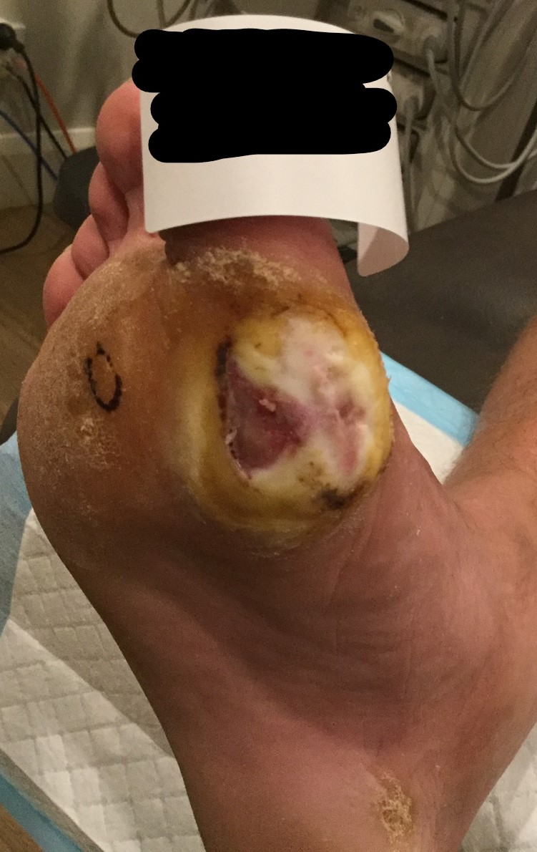
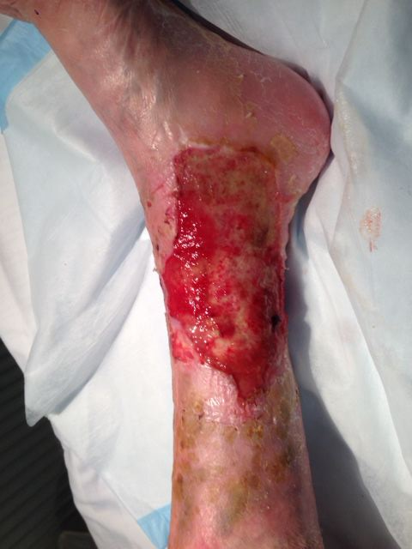
Background -
Chronic lower limb ulcers remain a significant health burden around the world
Affecting
1 % of adult population,
3.5% of 65 yo or older,
5 % of 80 yo or older
Agale, Shubhangi Vinayak. “Chronic Leg Ulcers: Epidemiology, Aetiopathogenesis, and Management.” Research article. Ulcers, 2013. https://doi.org/10.1155/2013/413604.
Notes:
Chronic lower limb ulcers remain a significant health and economic burden around the world.
The effect 1% of the adult population and 5% of those over 80 years of age.
The common precipitating causes are ischaemia, stasis including venous stasis and repetiive trip pressure.

Slide 4
Treatment Paradigm
Remove the noxious insult
Provide a supportive environment
Wait for the magic to happen
Even after correction of these factors, healing can be slow
Poor nutrition has long been associated with poor healing.

Slide 5
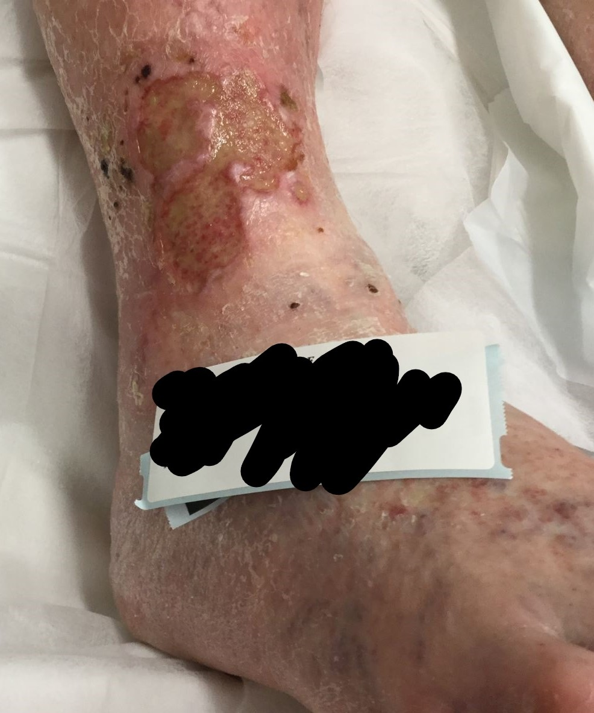
Index Case - Presentation
82 yo woman with a 5 year history of recurrent ulcers
MHx
PVD
Chronic Venous Insufficiency
S.aureus, P. aeruginosa,
Gout
AF (warfarin), Nil DM, Nil IHD, Nil Smoking Hx

Slide 6
Index Case - Treatment
Angioplasty
External Compression
Hospital Admission and leg Elevation
Antibiotics
Dressings and debridement
Nutritional screen:
Serum Ascorbic Acid 6 µmol/L
(26 -85 µmol/L)

Slide 7
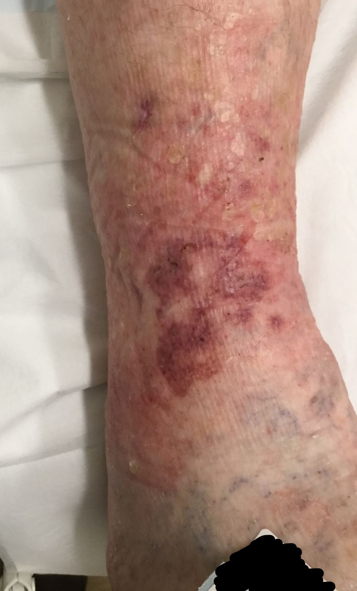
Index Case - Treatment
Two months of supplementation with
1000mg Vitamin C
Nutritional screen: Ascorbic Acid 120 umol/L
Since 2016, chronic wound patients been offered a nutritional screen
Zinc
Vitamin C
Haemoglobin
Albumin

Slide 8
Aims -
An audit of the nutritional screens was undertaken to:
Determine the prevalence of nutritional deficiency and compare it to other population groups
Identify patterns of deficiency and at-risk subgroups
Plan for future surveillance protocols

Slide 9
Severe Vitamin C deficiency was surprisingly common
Spoiler Alert:

Slide 10
Method –
Analysis of electron medical records at a single institution
The earliest nutritional screens after initial presentation with lower limb ulcer persisting for 4 weeks or greater.
Record
Age and Gender
Ulcer location – calf, foot, malleolus
Inhibitors to healing – Ischemia/ Chronic Stasis/Pressure
Diabetic status
Smoking status - active smoker/non-smoker
Vitamin C, Zinc, Albumin, Haemoglobin
Notes:
Vitamin C levels listed as undetectable were listed as 5 umol/L

Slide 11
Demographics of patients, ulcer characteristics (N=92)
Gender | Male n₁= 53 | Female n₂= 39
Age | Mean = 75 years | St Dev= 12 years
Pathology Lab. | DHM n₁ = 58 | Laverty n₂=34
Diabetic status | Diabetic n₁= 33 | Non-Diabetic n₂=59
Smoking status (N=88) | Active Smoker n₁=11 | Non-Smoker n₂= 75
Ulcer Location | Calf n₁ = 52 | Malleolus n₂ =11 | Foot n₃=24
Healing Inhibitor* | Stasis n₁ = 47 | Ischemia n₂ = 45 | Pressure n₃ = 12
* Lesions may result from more than one healing inhibitor, so category totals add to > 92.
Notes:
A total of 92 records were available for analysis
Severe Vitamin C deficiency was noted in 40. 2% (37/92)

Slide 12
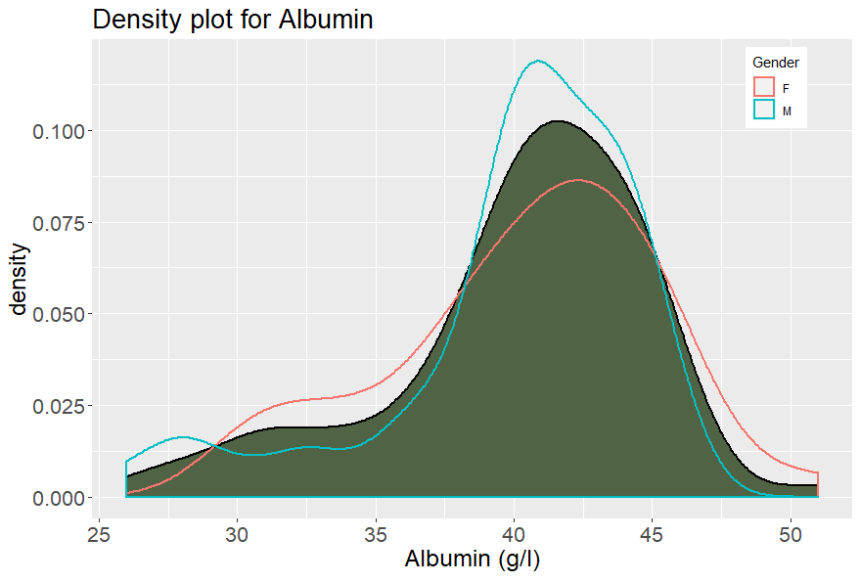
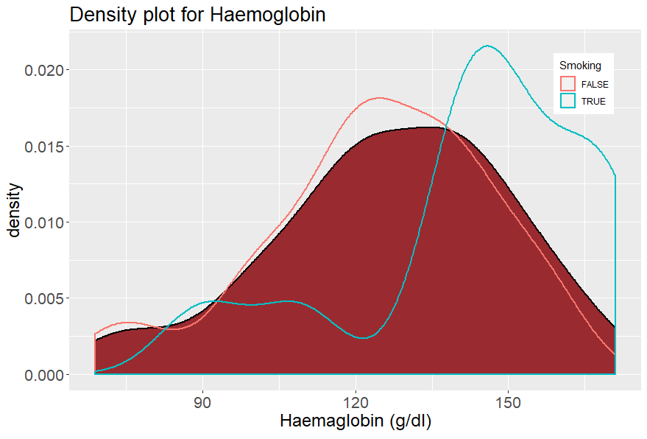
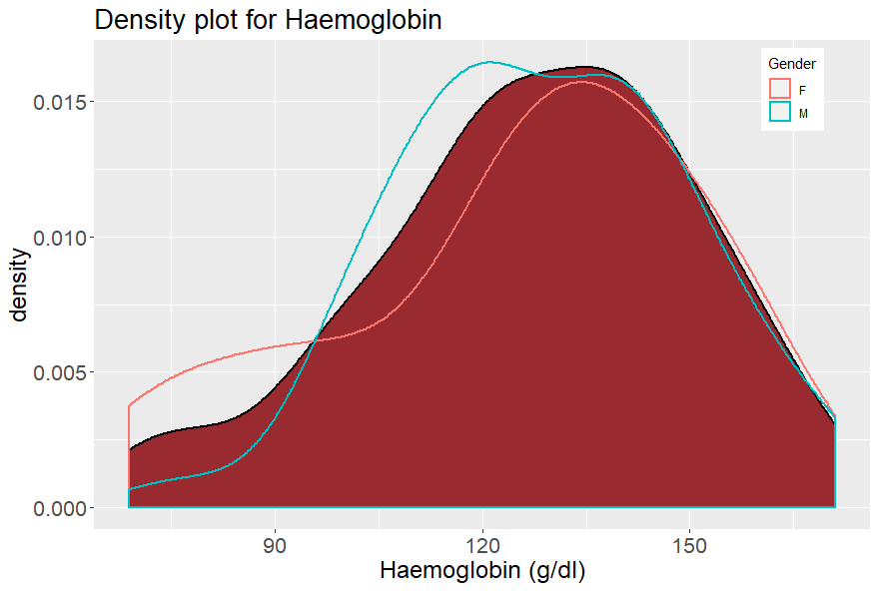
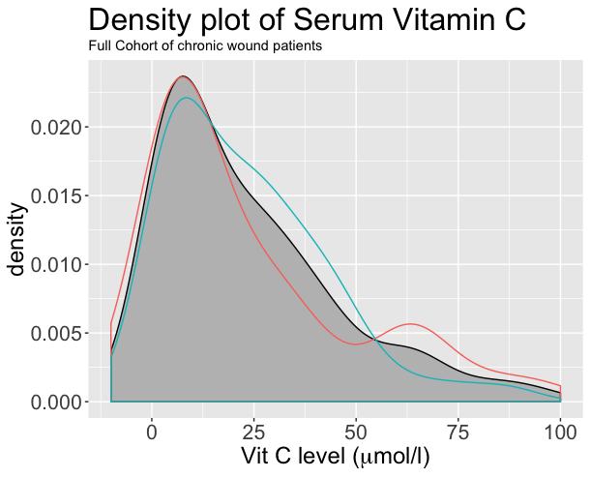
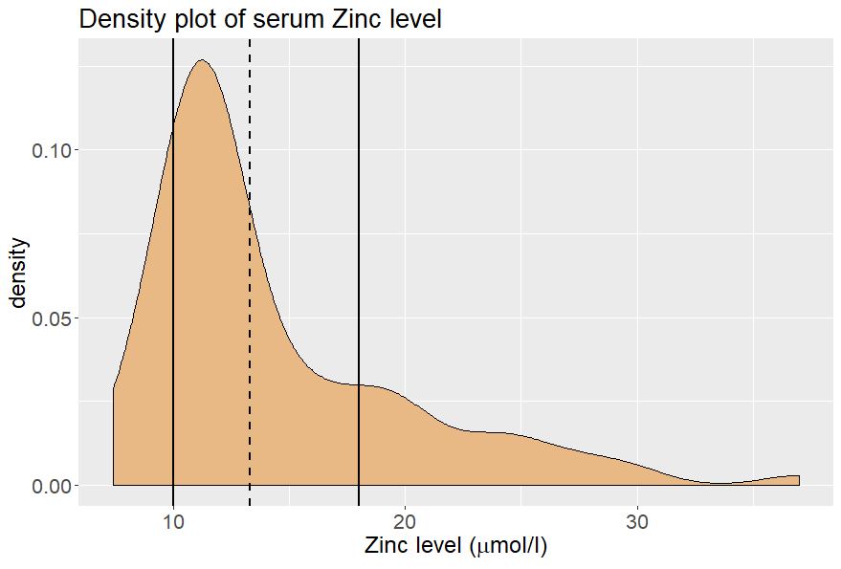
Notes:
10 – 18 umol/L == 65.4 ug/dL - 117 Morning Fasting
8.8 umol/L == 56.5ug/dL
Geometric Mean (NHANES 2011-2014, 13.32 umol/L
CF Geomtric Mean for current Data 13.48+/ 1.4

Slide 13
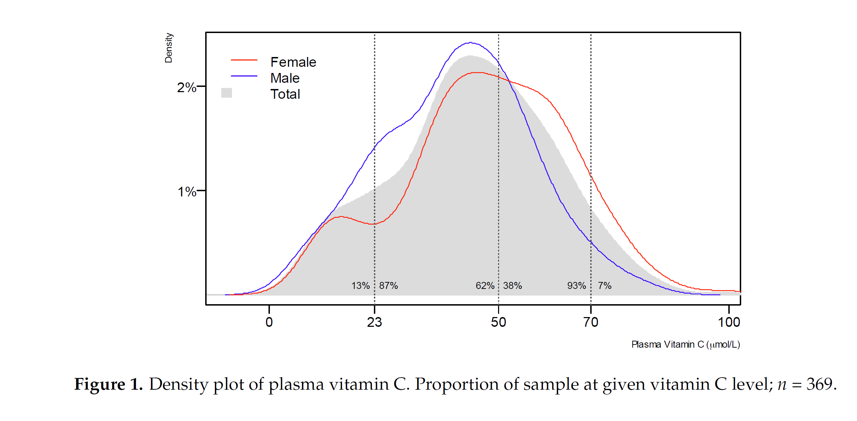
Serum Vitamin C in a normal population
The CHALICE STUDY: Pearson et. Al, 2017 -
Notes:
We show here the detailed from the CHALICE study off 369 50yo residents of the New Zeeland city of Canterbury. The distribution is normally distributed around the mean of 44 umol/L, with only 2.4% in the severe deficiency range.

Slide 14
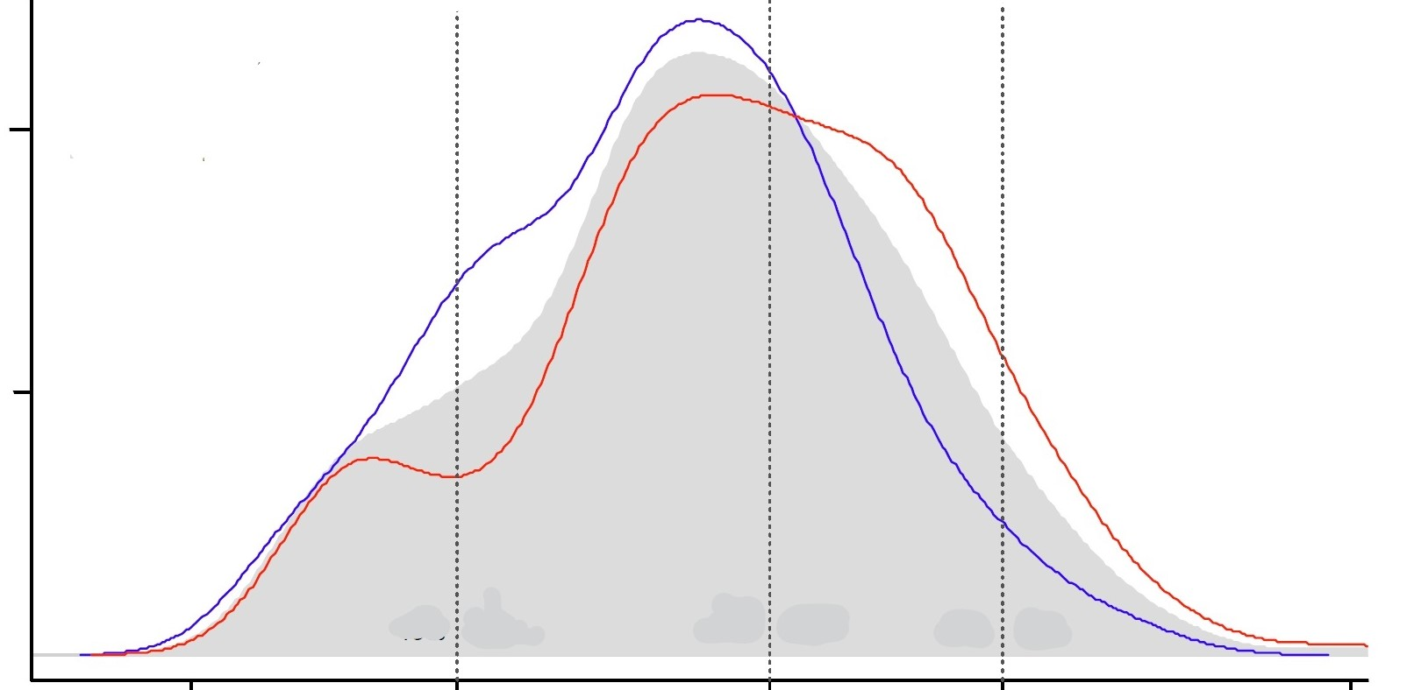
Notes:
We compare that with our cohort of 92 patients with leg ulcers
The distribution is markedly skewed towards lower values
The mean serum vitamin C is just 27 umol, with 40% in the severe deficiency range.

Slide 15
Severe Vitamin C deficiency was surprisingly common

Slide 16
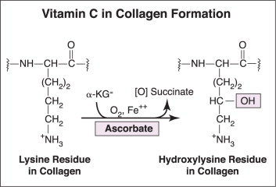
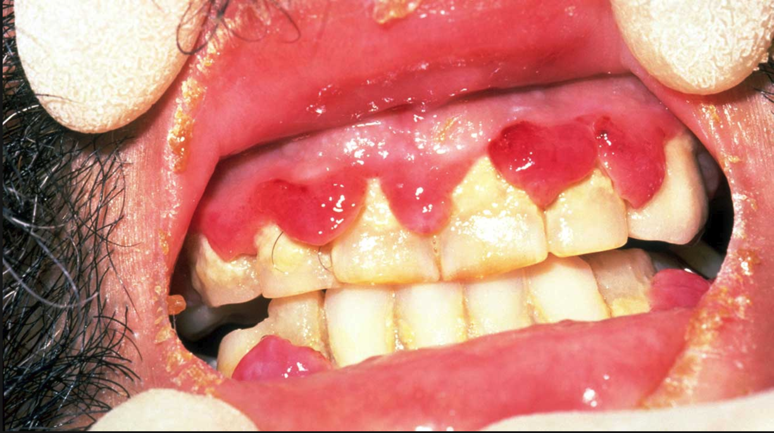
Physiology of Vitamin C in wound healing
Collagen Synthesis
Serum vitamin C < 11.4 µmol/L = severe deficiency
“Ascorbic Acid Deficiency - an Overview | ScienceDirect Topics.” Accessed August 11, 2019. https://www.sciencedirect.com/topics/medicine-and-dentistry/ascorbic-acid-deficiency.
Nutrient Reference Values for Australia and New Zealand Executive Summary,” https://www.nhmrc.gov.au/sites/default/files/images/Nutrient-reference-aus-nz-executive-summary.pdf
Notes:
Cofactor for
numerous enzymes required for hydroxylation of proline and lysine in synthesis of collagen
enzymes
Scurvy is the clinical manifestation of vitamin Cdeficiency. The typical findings of scurvy are generalized perifollicular petechial bleeding, commonly involving the lower extremities, associated with gingival hypertrophy and bleeding,¹²⁵⁻¹²⁸ with 80% of the affected having anemia.¹²⁵ Pseudoparalysis caused by lower extremity pain and edema is a common feature.

Slide 17
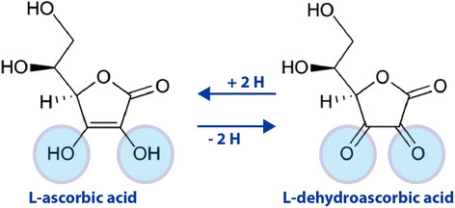
Physiology of Vitamin C in wound healing
Reducing agent and free radical scavenger
Important role in reducing ROS, NOS
known to fall
in sepsis
in burns patients in ICU
after elective surgery
The Oxidation-Reduction (Redox) Reaction of Vitamin C,...” ResearchGate. Accessed August 11, 2019. https://www.researchgate.net/figure/The-oxidation-reduction-redox-reaction-of-vitamin-C-molecular-forms-in-equilibrium_fig2_306111617
Fukushima, Ryoji, and Eriko Yamazaki. “Vitamin C Requirement in Surgical Patients.” Current Opinion in Clinical Nutrition and Metabolic Care 13, no. 6 (November 2010): 669–76. https://doi.org/10.1097/MCO.0b013e32833e05bc.

Slide 18
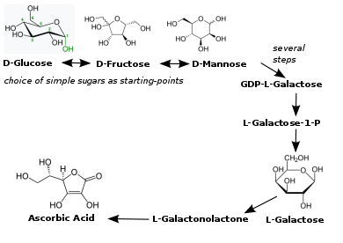
Background : Vitamin C synthesis
Vitamin C is synthesized from simple sugars
Transport across gut lumen and across cell membrane is dependant on
Sodium dependant transporters
Glucose transporters (GLUT1, GLUT3 +/- GLUT4)
Wilson, John X. “Regulation of Vitamin c Transport.” Annual Review of Nutrition 25, no. 1 (July 12, 2005): 105–25. https://doi.org/10.1146/annurev.nutr.25.050304.092647.

Slide 19



Background : L-gulonolatone oxidase
Notes:
Humans, like other primates and some other species, cannot synthesise vitamin C

Slide 20
^{y) VI}
Vitamin C recommended daily intake (mg/day)
 | US Food and Nutrition Board¹ | EU | Aust & NZ NHMRC | German Nutirional Society (GDE)⁴ | Japan Nat. Inst of Health | Health Canada
Adult Male | 90 | 80mg | 45 | 110 | 100 | 90
Adult Female | 75 | 80mg | 45 | 95 | 100 | 75
Smoker (male) | 125
Smoker (female) | 110
Dietary Reference Intakes for Vitamin C, Vitamin E, Selenium, and Carotenoids. Washington, D.C.: National Academies Press, 2000. https://doi.org/10.17226/9810.
3 ““Nutrient Reference Values for Australia and New Zealand Executive Summary,” https://www.nhmrc.gov.au/sites/default/files/images/Nutrient-reference-aus-nz-executive-summary.pdf
4. Society (DGE), German Nutrition. “New Reference Values for Vitamin C Intake.” Annals of Nutrition and Metabolism 67, no. 1 (2015): 13–20. https://doi.org/10.1159/000434757.
5. Shibata, Katsumi, Tsutomu Fukuwatari, Eri Imai, Takashi Hayakawa, Fumio Watanabe, Hidemi Takimoto, Toshiaki Watanabe, and Keizo Umegaki. “Dietary Reference Intakes for Japanese 2010: Water-Soluble Vitamins.” Journal of Nutritional Science and Vitaminology 59, no. Supplement (2012): S67–82. https://doi.org/10.3177/jnsv.59.S67.

Slide 21
Vitamin C Deficiency in modern populations
Serums vitamin C < 11.4 µmol/L = severe deficiency can be associated with the development of scurvy.
Vitamin C deficiency is rare in industrialised nations and becoming more so
It is still seen in high risk populations lower socioeconomic demographics obese patients.
Average serum levels are lower in smokers and diabetic patients
Notes:
Rates of deficiency are becoming less common in industrialised society but not unknown

Slide 22
Ulcer Patients:
mean 27 µmol/L,
40% severe deficiency
Reference Cohort:
mean 44 µmol/L,
2.4% severe deficiency
Notes:
We compare that with our cohort of 92 patients with leg ulcers
The distribution is markedly skewed towards lower values
The mean serum vitamin C is just 27 umol, with 40% in the severe deficiency range.

Slide 23
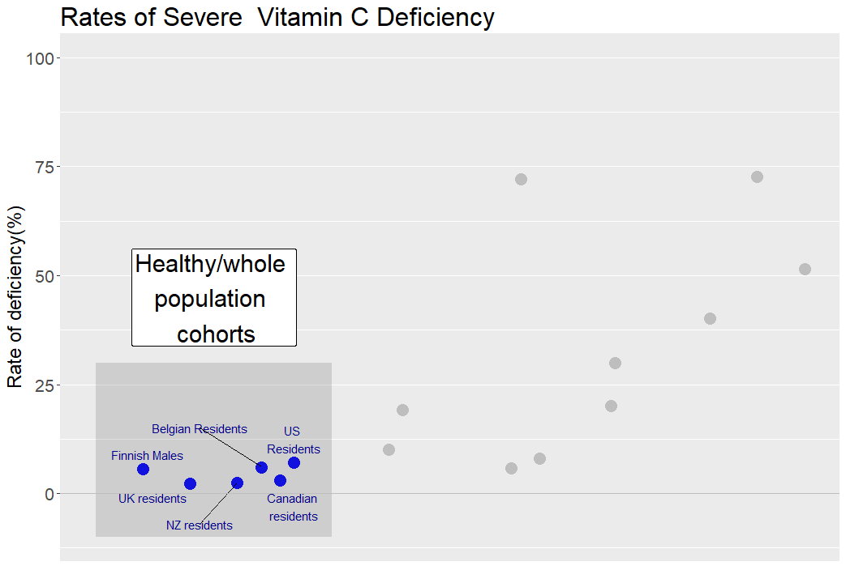
Notes:
Healthy populations studies find very low rates of C deficiency- less that 3%

Slide 24
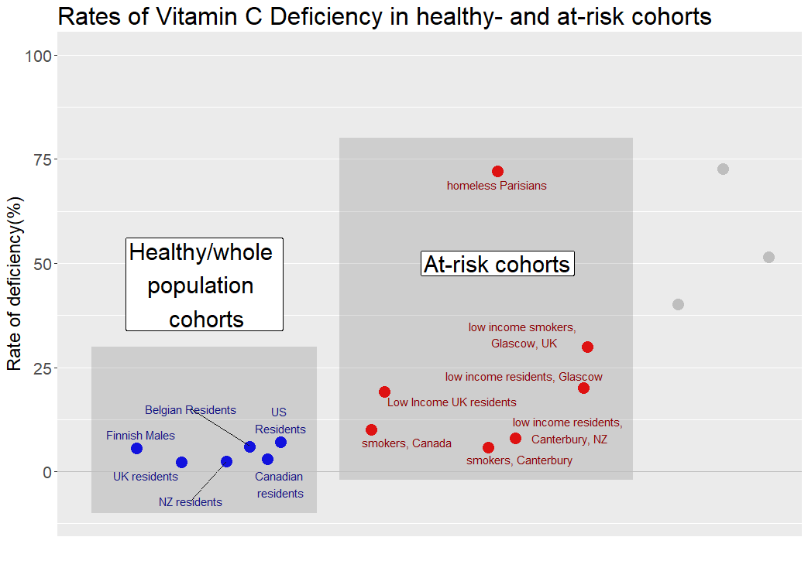
RESULTS: Literature Review
Notes:
The rates increase in at risk population studies

Slide 25
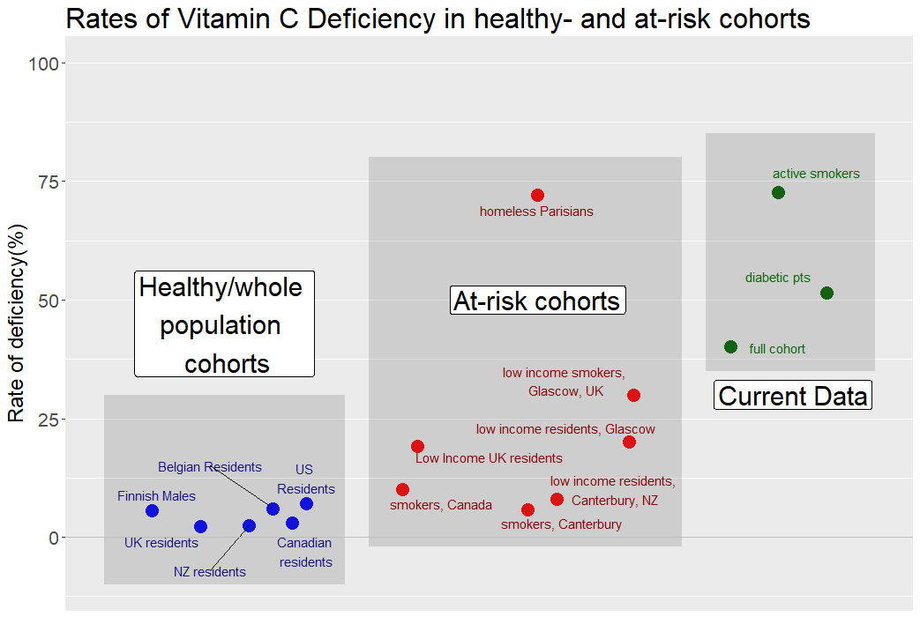
Notes:
When compared with data from the literature, the presence of leg ulcers is potentially another factor leading to C deficiency

Slide 26
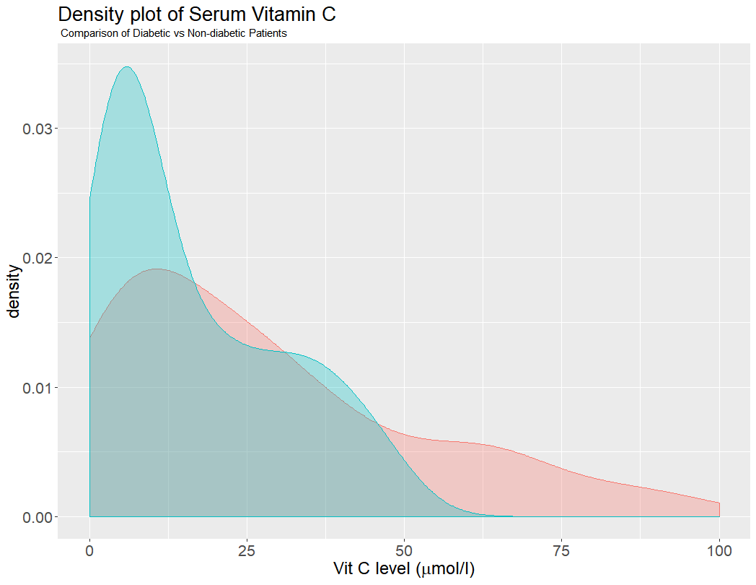
Diabetic Patients (N=33)
Mean 22 µmol/L
51 % - severely deficient
Non-Diabetic Patients (N=57)
Mean = 29 µmol/L
21 % severely deficient

Slide 27
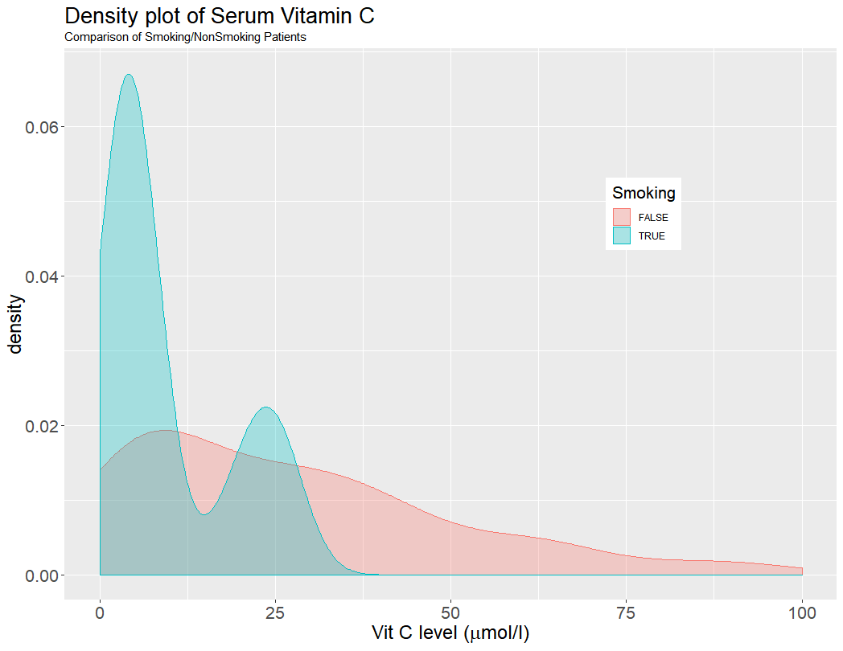
Active Smokers (N=11)
Mean 22 µmol/L
73% - severely deficient
Non-Smokers (N=75)
Mean = 30 µmol/L
30% severely deficient

Slide 28
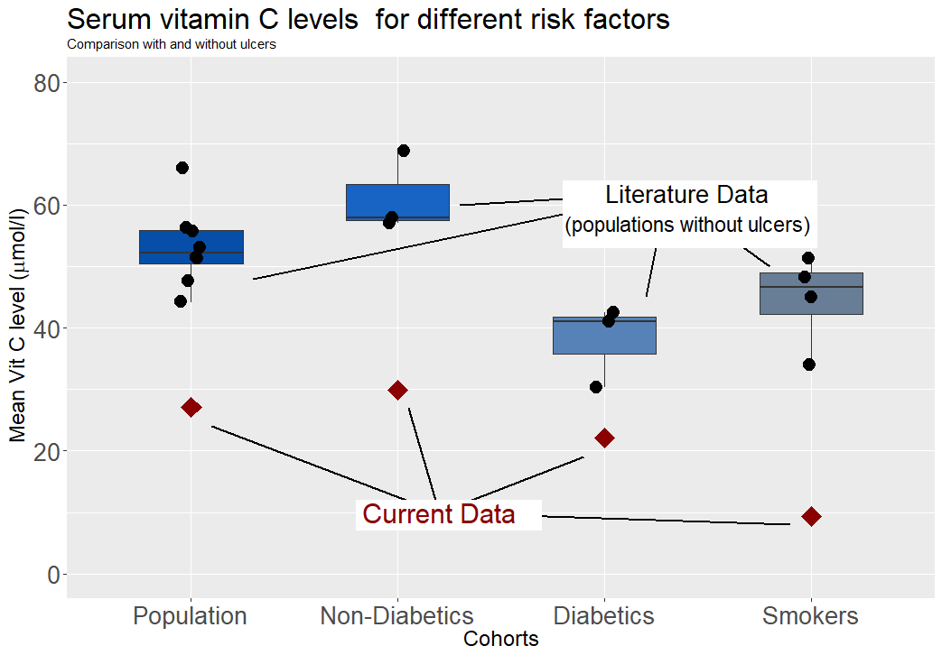

Slide 29
CONCLUSIONS & DISCUSSION:
Rates of severe vitamin C depletion are remarkably high in outpatients patient with lower limb ulcers:
40% are deficienct vs 3-6% in population studies
Additional risk factors such as smoking and diabetes increase the risk of depletion even further.
51% of diabetic patients
73% of active smokers

Slide 30
Weaknesses of this study :
A referred cohort of patient is subject to selection bias
Serum levels may not be the best marker for clinical deficiency
Incorrect handling of serum sample may lead to artificially low results

Slide 31
DISCUSSION:
Nutritional screening for patients with non-healing ulcers is justified.
Active smokers and diabetic patients with lower limb ulcers should be considered for Vitamin C supplementation at first presentation.

